Slide 1
No!
Why, When, and How to say “No”
Ayesh Karunaratne | https://ayesh.me/talk/No
Notes:
Download slides if necessary

Slide 2
Hallo!

Slide 3
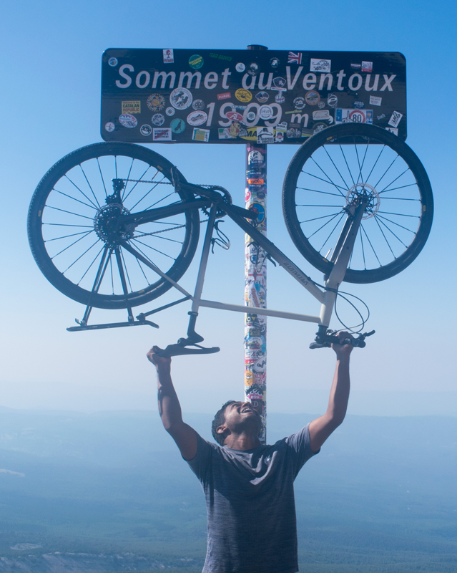
Ayesh Karunaratne
Freelance Software Architect
https://ayesh.me
Ayesh
@Ayeshlive
Notes:
Came to Europe 2 months ago.
Hiking, Ferry, Hitchhiking, Train, Buses, lots of buses, Flights, etc. So please don’t check emails during the event.

Slide 4
PHP 7+
The why’s and the how’s
Ayesh Karunaratne
No, I’m just joking… I’m not natively English, and if you have any questions, please, um… raise your hand.
[audience clearly confused]
Just look at the bottom of the screen.
So… One of the reviews of that presentation was that my English dialect was hard to follow.
For this time, I have added English subtitles to the presentation.
Notes:
So… One of the reviews of that presentation was that my English dialect was hard to follow.
For this time, I have added English subtitles for the presentation.
Just look at the bottom of the screen.
No, I’m just joking. I’m not natively English, and if you have any questions, please raise your hand.

Slide 5
Notes:
The word with most impact in any language. Sounds negative, but it is absolutely necessary have ready, and be brave to say whenever necessary.

Slide 6
No!
Notes:
Sounds negative, but the word with most impact.

Slide 7
Affiliate codes
Useless Badges
Languages
Time zones
Coupon code aggregator
Gamification
Currency
Localization
Coupon code platform
User Ranking
Referral platform
ACME REVIEWS INC.
Consumers
Generate/Validate codes
Review platform
Contact Users
Social Login
Payment Handling
Custom Questions
Chat
Security, duplicates
Anonymous
Local Payment Options
Full Surveys
Notes:
There are many more I skipped. We wanted to make the servers automatically expandable, embedding reviews, Google rich text markup, Amzon SES, SNS, CloudFront, etc.

Slide 8
19 Months

Slide 9
Cost $ 70,000

Slide 10
19 Free Trial Customers

Slide 11
3 Paying Customers

Slide 12
$ 27 Revenue

Slide 13
Notes:
Sounds negative, but the word with most impact.

Slide 14
Focus

Slide 15
WordPress
Focuses on end-users
Notes:
I made fun of WordPress in my PHP 7 session, because they still support PHP 5.2 too, but on the other hand, they focus on end users.
There is a huge market for WordPress hosting for non-technical people.

Slide 16
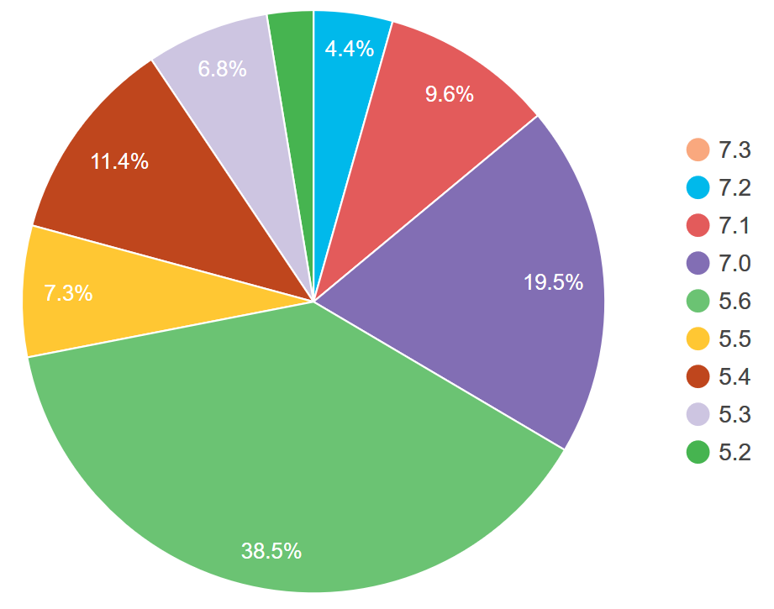
https://wordpress.org/about/stats/
Notes:
This is absolutely horrible.
- No autoloaders
Dozens of polyfills.

Slide 17
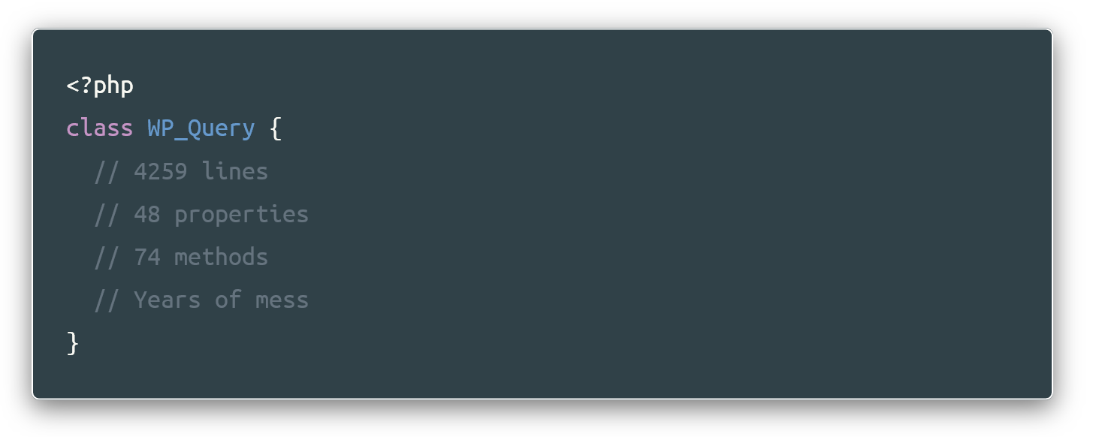
https://github.com/WordPress/WordPress/blob/master/wp-includes/class-wp-query.php
Notes:
Nightmare for developers. One of the most used pieces of code, PHP developers make fun of this.

Slide 18
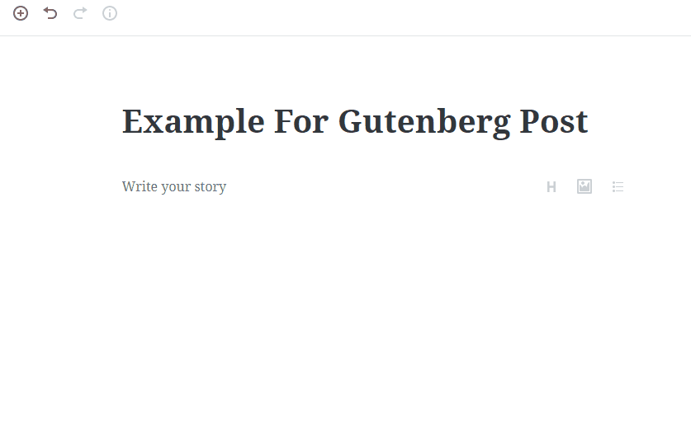
Notes:
Even your cat can fill this.

Slide 19
30% of the entire web runs on WordPress
https://w3techs.com/technologies/details/cm-wordpress/all/all

Slide 20
Apple
Focuses on simplicity and trouble-free functionality

Slide 21
“
People think focus means saying yes to the thing you've got to focus on. But that's not what it means at all. It means saying no to the hundred other good ideas that there are. You have to pick carefully. I'm actually as proud of the things we haven't done as the things I have done. Innovation is saying no to 1,000 things.
“
Steve Jobs (Apple Worldwide Developers' Conference, 1997)

Slide 22
Apple Inc: $1 Trillion Market Cap
https://w3techs.com/technologies/details/cm-wordpress/all/all
Notes:
3 months rent in Munich
20 billion burgers

Slide 23
Leadership

Slide 24
“
A primary cause of complexity is that software vendors uncritically adopt almost any feature that users want.
“
Niklaus Wirth
Notes:
Swiss computer scientist
Several programming languages, incl Pascal.
Niklaus Veert

Slide 25
It’s important to have a leadership that unbiasedly listens to user criticism, but still makes the decisions for the future of the project.
Notes:
Doesn’t matter it makes him unpopular.

Slide 26
Drupal
Notes:
We have this model figured out quite well.

Slide 27
Project Lead
Core Maintainers
Module Maintainers
Code Review Administrators
Security Team
Community Working Group
Drupal.org and CI Infrastructure
Drupal Association
User Groups

Slide 28
Communication

Slide 29
Linux
Notes:
This is a massive project with hundreds of contributors, and is designed to run on millions of devices.

Slide 30
Rule of Clarity
Rule of Repair
Rule of Generation
Rule of Extensibility
Rule of Silence
Rule of Economy
Rule of Composition
Rule of Transparency
17 Unix Rules
Rule of Separation
Rule of Robustness
Rule of Diversity
Rule of Simplicity
Rule of Least Surprise
Rule of Optimization
Rule of Representation
Rule of Parsimony
Rule of Modularity
Notes:
Contributors and users can evaluate themselves. Interesting read

Slide 31
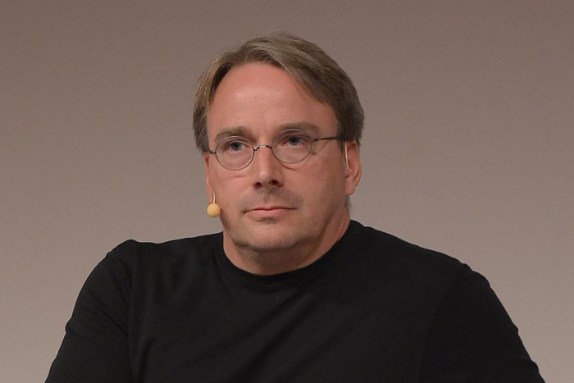

Slide 32
Documentation leaves less room for surprises
When the leadership says “No”.

Slide 33
Being friendly and cheerful helps to have an
Active and loyal community.
Saying no isn’t fun, but “Your contribution doesn’t match this project’s criteria” feels less
personal than “I don’t like your contribution”.
Symfony documentation
Notes:
Symfony pull requests are pretty good, with good discussions.

Slide 34
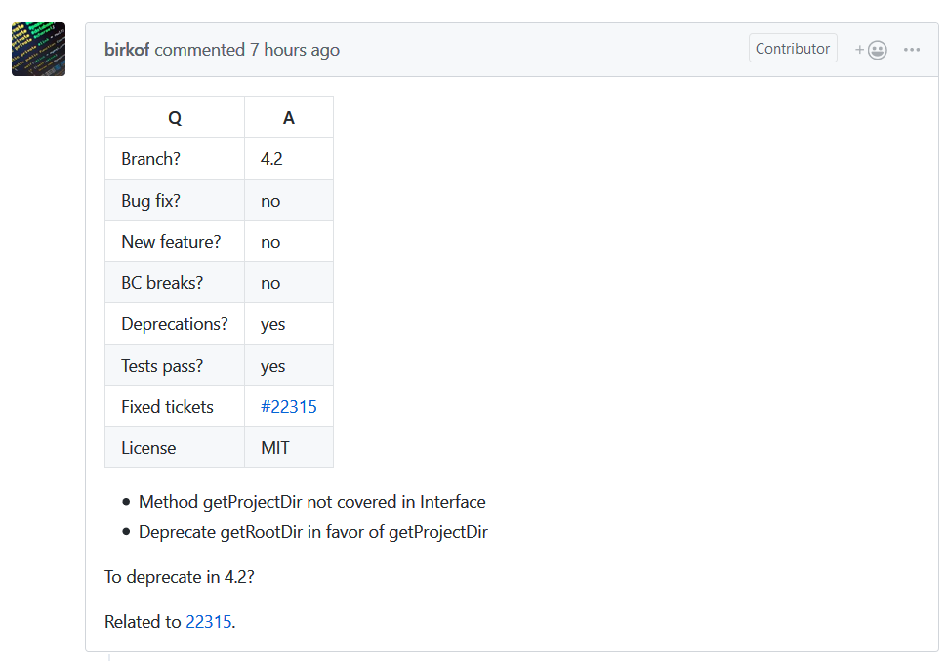
Notes:
https://github.com/symfony/symfony/pull/28434

Slide 35
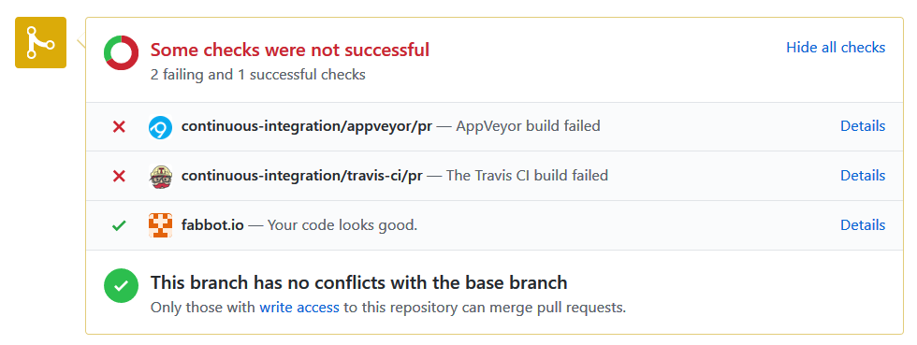
Notes:
Symfony pull requests are pretty good, with good discussions.

Slide 36
Extensibility
Notes:
Saying No doesn’t mean you lose functionality. What you need is maintainable code, properly separated, each with their own responsibilities.

Slide 37
“
Our ultimate goal is extensible programming (EP). By this, we
mean the construction of hierarchies of modules, each module adding new functionality to the system.
“
Niklaus Wirth

Slide 38
Approaches for Extensibility in Code
SOLID principles (link)
Principle of least privilege (for security)(link)
Finely defined support windows
API versions, Semantic versioning
Plugin-based architecture
Hierarchy of leadership
Notes:
Clean Code by Rober C Martin.
Paul M Jones “Modernizing Legacy applications”

Slide 39
[dramatic pause]
Notes:
Dramatic pause.

Slide 40
Focus
Communication
Leadership
Extensibility
Notes:
Saying No doesn’t mean you lose functionality. What you need is maintainable code, properly separated, each with their own responsibilities.

Slide 41
The Less Is More
Notes:
Saying No doesn’t mean you lose functionality. What you need is maintainable code, properly separated, each with their own responsibilities.

Slide 42
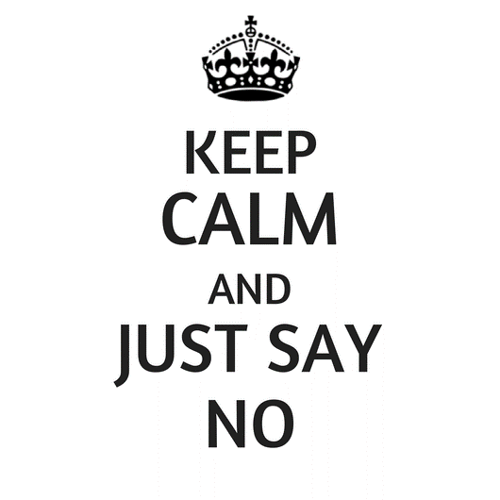

Slide 43
Thank You
Danke

Slide 44
Become a Drupal contributor Friday from 9am
First timers workshop
Mentored contribution
General contribution
Notes:
I will be working on PHP 7.3 compatibility fixes.

Slide 45
No!
Why, When, and How to say “No”
Ayesh Karunaratne | https://ayesh.me/talk/No

